Slide 1
SpaceX Falcon 9 Launch Success Predictive Analysis
IBM Data Science Applied Capstone Project
Problem Statement: Space launch operations are heavily limited by hardware costs. SpaceX cuts costs dramatically by reusables (landing the Falcon 9 first-stage booster). The goal of this project is to predict whether a Falcon 9 first stage will land successfully, optimizing launch economic decisions.
GitHub Repository URL: https://github.com/skmdrakib/SpaceX-Data-Science-Capstone

Slide 2
Executive Summary
Objective
Gather, clean, analyze, and build machine learning classifiers to predict Falcon 9 first-stage landing outcomes.
Methodology:
Data Collection: Combined SpaceX REST API endpoints with Wikipedia web scraping via BeautifulSoup.
Data Wrangling & EDA: Formatted data types, processed missing data values, and performed querying via SQLite/IBM Db2.
Data Visualization: Explored features via Folium spatial maps, Seaborn plots, and a Dash Dashboard.
Machine Learning: Trained and hyperparameter-tuned 4 distinct classification models (Logistic Regression, SVM, Decision Tree, KNN).
Key Results: All 4 optimized machine learning models yielded an identical test set classification accuracy of 83.33%.

Slide 3
Data Collection – SpaceX API
Process Description:
Sent HTTP request payloads via Python requests.get() to the official SpaceX API endpoint.
Unpacked complex, nested JSON fields into flat tabular features using pd.json_normalize().
Filtered columns to restrict entries purely to Falcon 9 launches (removing older Falcon 1 entries), reducing the core records down to 90 rows.

Slide 4
Data Collection – Web Scraping
Process Description:
Targeted the "List of Falcon 9 and Falcon Heavy launches" page on Wikipedia.
Requested raw page components and passed the layout directly into a BeautifulSoup object.
Extracted HTML table rows (<tr>) systematically to parse and create clean column vectors for launch dates, booster configurations, payloads, and mission outcomes.

Slide 5
Data Wrangling Methodology
Data Cleaning Checklist:
Handled missing variables: Found 26 missing entries in the landingPad feature column.
Imputed values: Replaced missing payload mass values (None) with the calculated dataset mean column value.
Binary Classification Encoding: Converted raw textual mission outcomes into numbers. Unsuccessful outcomes were classified as 0, while successful landings (like drone ship or ground pad) were encoded explicitly as 1.

Slide 6
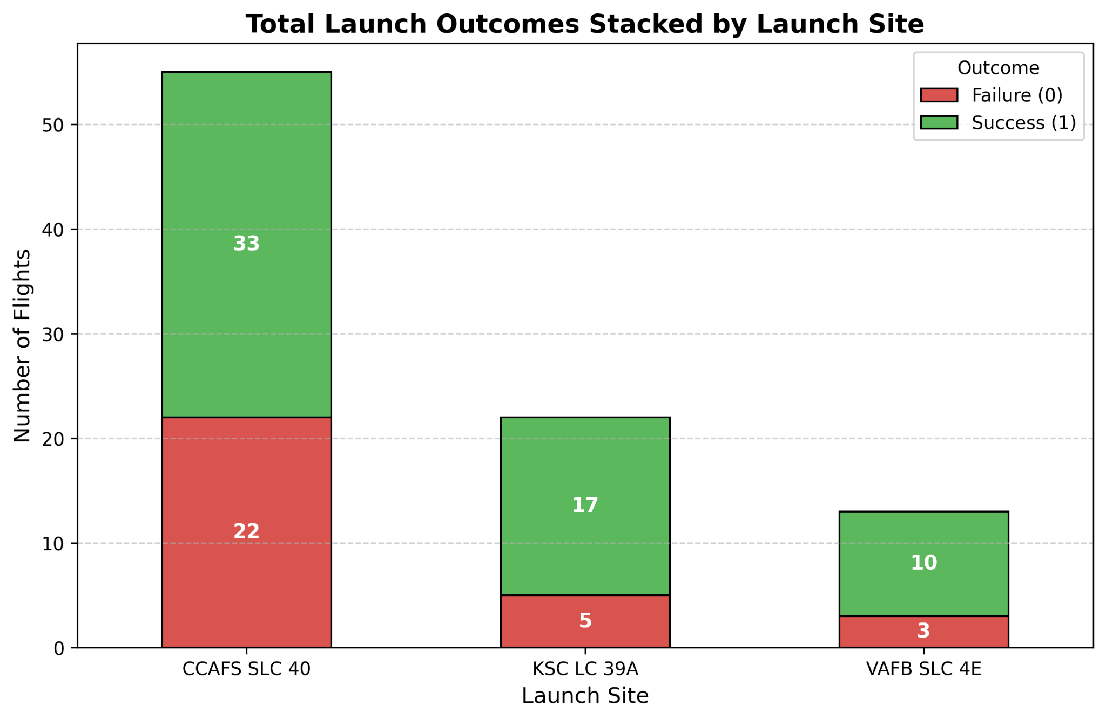
EDA with Data Visualization
Key Visual Patterns Discovered:
Flight Number vs. Launch Site: Early flights clustered heavily around CCAFS LC-40 with volatile failure rates. As flight counts increased past 40, success markers became heavily concentrated across all sites.
Payload Mass vs. Launch Site: Heavier payloads (>8,000 kg) show a very high percentage of successful landing outcomes across the board.
Yearly Success Trend: Plotting success rates over time reveals a steady upward slope, validating technical improvements and mature engineering iterations from 2013 onward.

Slide 7
EDA with SQL
Core Queries Performed:
SELECT DISTINCT Launch_Site FROM SPACEXTBL; \(\rightarrow \) Confirmed 4 unique string designations.
SELECT COUNT(*) FROM SPACEXTBL WHERE Launch_Site = 'CCAFS SLC-40'; \(\rightarrow \) Evaluated total launches (55 records).
SELECT SUM(PAYLOAD_MASS__KG_) AS Total_Payload_Mass FROM SPACEXTBL; \(\rightarrow \) Aggregate performance calculation grouped by booster configurations.

Slide 8
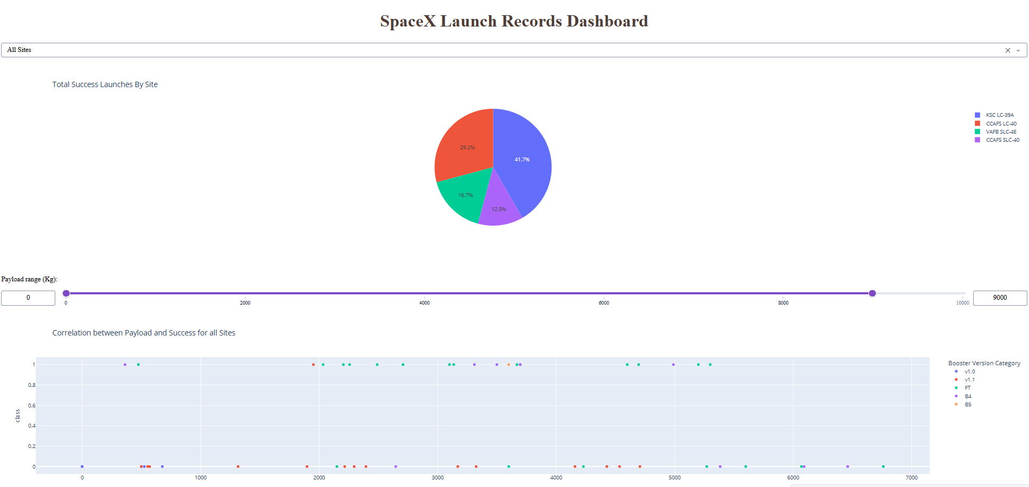
Interactive Visual Analytics
Folium Spatial Map: Used map rendering vectors to plant coordinate points for all main launch areas. Bound a MarkerCluster layer to handle dense coordinate nodes neatly and layered polyline vectors calculating physical proximity distances to coastal boundaries and transit links.
Plotly Dash Application: Created an interactive interface linking a global site selector drop-down box directly to a reactive pie chart breakdown (success/failure rates) and a payload-driven scatter chart split dynamically by color mapping.

Slide 9
Predictive Analysis Models & Final Conclusion
Model Accuracy Scoreboard (Test Dataset):
Logistic Regression: 83.33%
Support Vector Machine (SVM): 83.33% (Best configuration: sigmoid kernel)
Decision Tree Classifier: 83.33%
K-Nearest Neighbors (KNN): 83.33%
Analytical Inference: All models score identically because the test sample size is limited to exactly 18 evaluation records. The confusion matrix confirms the classification models struggle mostly with specific False Positives.
Conclusion: The predictive model confirms that high payload masses combined with later engineering versions strongly guarantee high-probability booster recovery success.

